Slide 1
Distributed Systems

Slide 2
Why Do We Need Distributed Systems?
Scalability
Fault Tolerance and Availability
Latency
Data Processing

Slide 3
What are Distributed Systems
Distributed programming is the art of solving the same problem that you can solve on a single computer using multiple computers.
(Source: Distributed Systems for Fun and Profit)

Slide 4
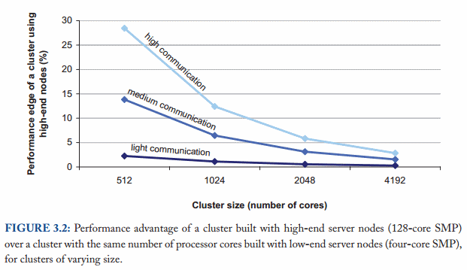
Cheap Hardware All The Way

Slide 5
Distributed Systems Are About Failure
What are our failure conditions?

Slide 6
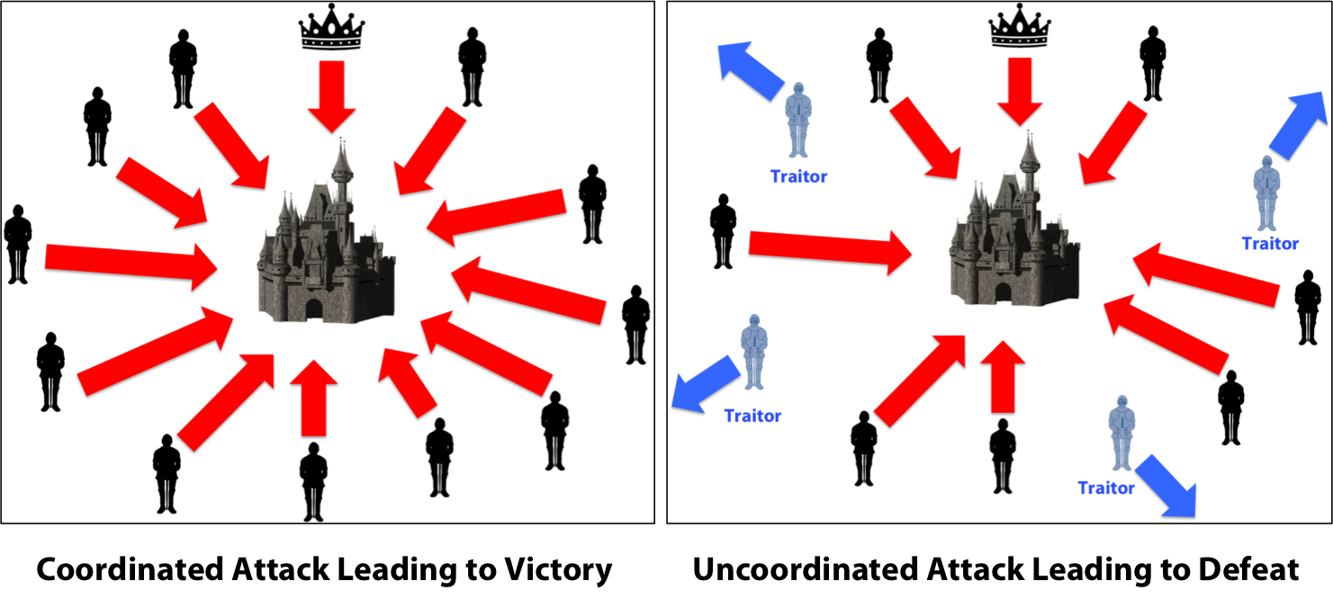
Byzantine Generals Problem

Slide 7
Guarantees: A solution
Provide guarantees on the conditions under which the system will work:
  If ½ of nodes are up, system will function normally
  System is strongly consistent: I promise that all nodes will always have the same data

Slide 8
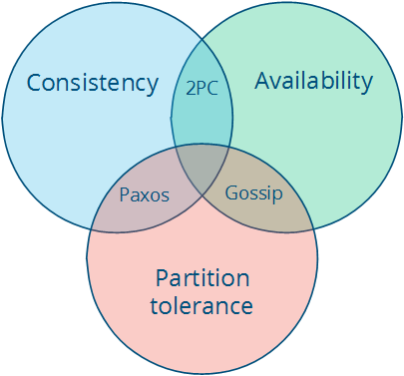
CAP Theorem

Slide 9
Case Studies
MapReduce
Chain Replication (specifically CRAQ)
VMware FT

Slide 10
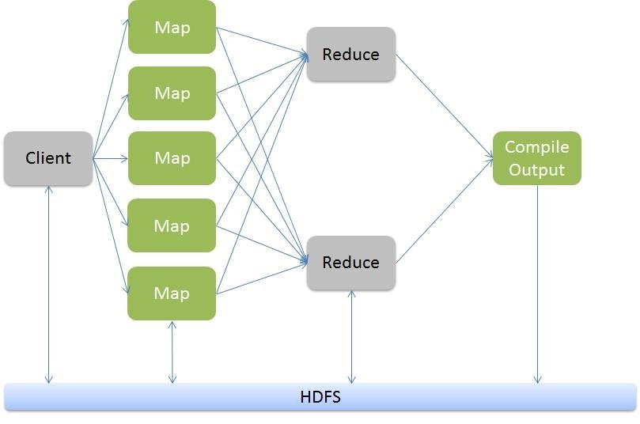
MapReduce: Distributed Data Processing

Slide 11
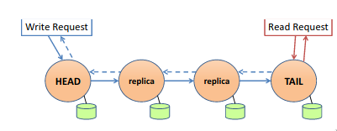
Chain Replication

Slide 12
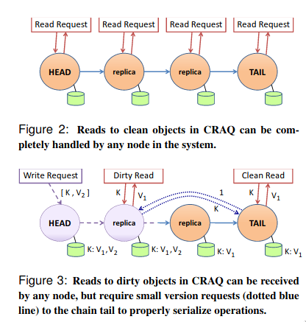
Object Storage on CRAQ

Slide 13
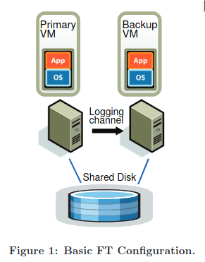
VMware FT

